Slide 1
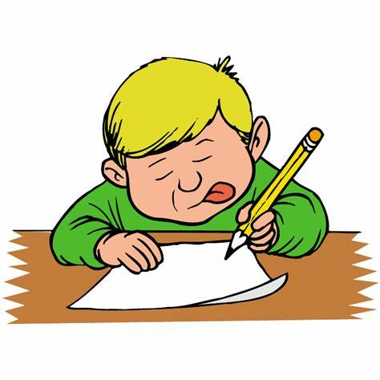
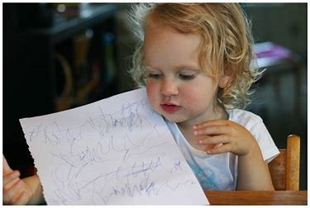
Welcome to the​
Reception
Writing
Inspire Workshop​
2024​

Slide 2
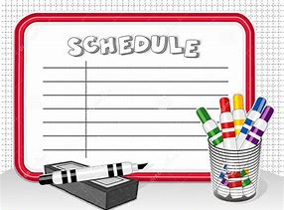
This morning
8.40-9.00-Learning about the process of writing in the Early Years.
9.00-9.20-Join your child in our "Busy Fingers" session.
9.20-9.30 Questions

Slide 3
Aims for this workshop…
To understand the importance of how physical skills aid writing.
To know how to help your child use their phonic knowledge to spell.
To learn about how to teach handwriting.

Slide 4
Writing is a very tricky thing to do!
Notes:
Think about how when you have learned to do something new e.g. Learning to drive there was lots to remember all at the same time-pedals/gears/indicators/mirrors/holding the steering wheel etc-it felt unnatural and hard to do. It was tiring!
Learning to write is the same-
what do I want to write, how do I spell that, what sounds do I need, what does that sound look like, how do I write that sound, spell that word, where do I write it on the page, what do I write with, what hand do I use, how do I hold my pencil. what was my sentence again?
Writing is not just about letters and sounds-spelling, it also requires thought to construct sentences, knowledge about conventions e.g. we write L-R/top to bottom and physical skills such as holding a pencil/holding your body upright/sitting comfortably.

Slide 5
Before children can even hold a pencil or write they must be physically ready
Notes:
Be being physically ready we mean:
Having control and developing strength over large body movements and muscles-elbow/shoulder/tummy. Having control and developing strength in smaller movements and muscles-fingers/wrists.
Also meaning developing links in the brain so that the brain is able do several things with both sides of the body at once e.g. holding a pencil in one hand/holding the page in the other.
Key in developing these skills are that writing will become something you do without having to think about it-second nature and not be a tiring/uncomfortable physical process which will switch them off before we have even started!!

Slide 6
Large physical movements-gross motor skills
Core stability
Upper body strength
Bi-lateral Co-ordination
Crossing the midline
Notes:
Lets look at some large physical movements that are key to writing-these are called Gross motor skills
Core stability is needed for good posture- it allows arms to be released to work-standing up to mark make/balance bikes/stand up from floor with hands on head/stand on one leg for 5 secs
Upper body strength-important to help to develop shoulder movement activities to develop this are-putting heavy things away-bricks, wheelbarrows/transporting big buckets/overarm throwing/tug of wars with scarves, bench presses
Crossing the midline-this helps with tracking across a page, activities like opportunities hand to knee/exercises on screen-wake up shake ups/would you rather/put things on opposite sides of table/clapping games
Bi-lateral co-ordination-both sides of the body doing 2 things at the same time-sequential e.g.
1. Symmetrical movts e.g. clapping, rolling pins, squeezing sponges
2.Alternating movts e.g. marching, beating a drum
3. Use hand to do differently-cutting/threading

Slide 7
Small physical movements-fine motor skills
Isolate fingers
Wrist mobility
Pincer grip
Notes:
Lets look at the small physical movements that are key to writing-these are called fine motor skills
As young children develop the muscles in their hands they develop the strength they need for the fine motor skill needed for holding a pencil, manipulating a pencil/wrists and writing for a sustained amount of time.
The expectations for PD ELG of Fine motor at the end of the Reception year are that children will “hold a pencil effectively in preparation for fluent writing-using a tripod grip in almost all cases”
To achieve this grip children need to be able to…
Isolate fingers-finger rhymes/finger strengthening activities-gloop/squeezing sponges or stress balls/playdough/blu-tac
Wrist mobility-dressing/skipping ropes/playing with musical instruments/zipping up coats/ribbon dancing/pom-poms
Pincer/tripod grip-peeling fruit/pegging/whiteboards and pens are easier as the pen glides across the board/thicker barrelled pens and pencils help to create the position naturally too.

Slide 8
Stages of pencil grip
Expectation at the end of the Reception
Notes:
How a child holds a pencil is dependent upon their age and their stage of development but the expectation at the end of Reception is picture 4, it is so important that we keep developing these large and small physical movements to enable them to reach this stage which is why you will see many opportunities everyday for developing this physical skill in both the indoor and outdoor classroom.

Slide 9
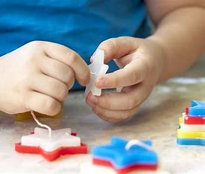
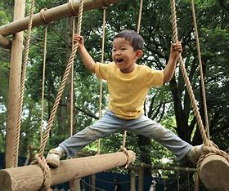
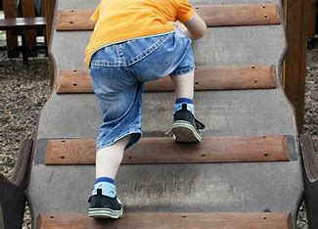
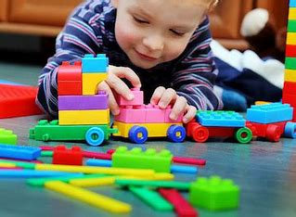
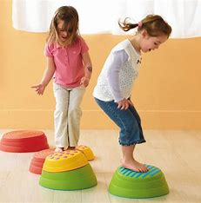
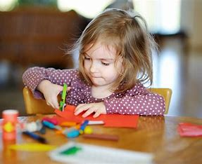
Gross and fine motor activities we promote
Fine motor
Sewing
Threading
Tap a shape
Jigsaws
Playdough
Building
Drawing
Colouring
Cutting
Sticking
Patterns
Painting
Letter shapes
Gross Motor
Climbing
Jumping
Balancing
Skipping
Batting
Swinging
Throwing
Skywriting
Water/paintbrushes
Chalk
Washing windows
Big drawing
Notes:
This is just some of the many activities....

Slide 10
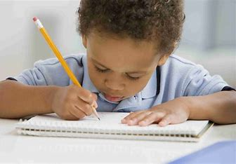
Writing in the Early Years
Encouraged to "mark make" as part of their play
Write every day during phonics
Have writing modelled to them
Work with an adult every week to practise writing for a purpose.
Notes:
Where do we see writing in Early Years...
Write as part of their play-birthday cards/lists/post-it notes/scoring etc
Learn how to use their phonic knowledge to spell and write words in phonics
I model writing for a purpose each week usually based upon on Pathways to Writing work. They learn that there is a reason to write e.g. this week they are writing a caption for a sign so that the animals in the story can read them and not go into the crocodile creek again.
Work in a small group with an adult to have a go at a writing task.

Slide 11
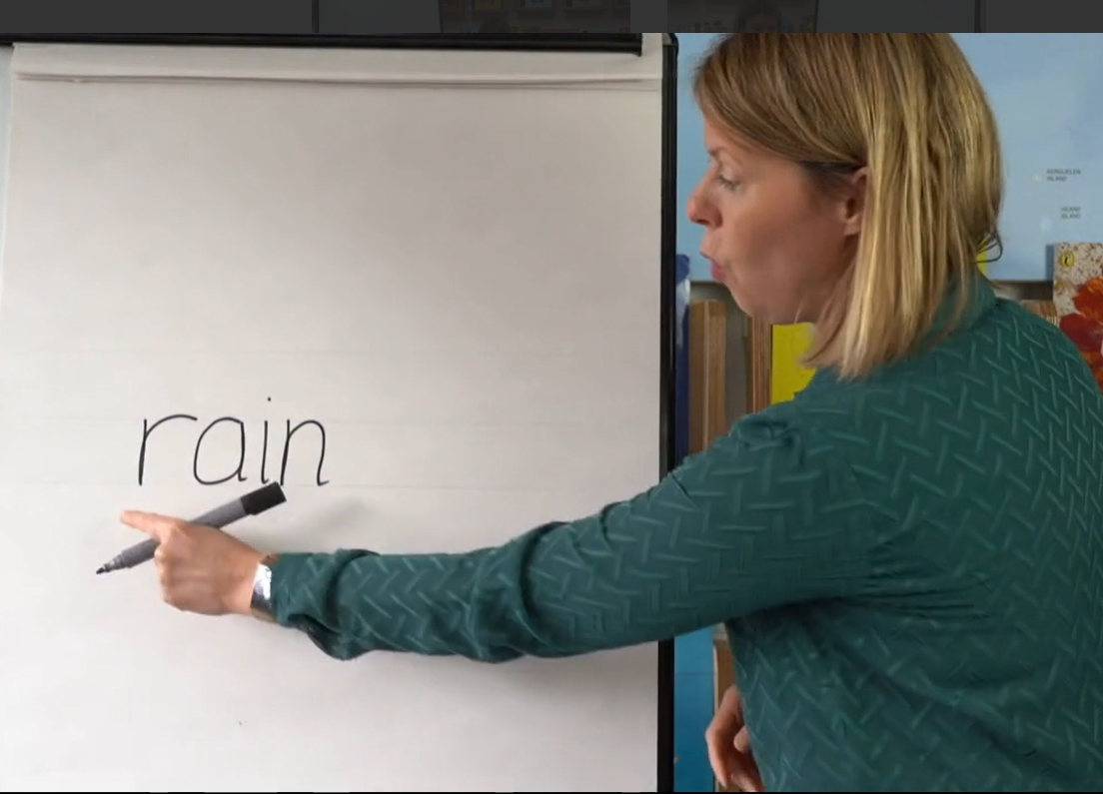
Writing in the Early Years
Segmenting
“Splitting up words into sounds”
Notes:
As part of our Little Wandle sessions the children learn to segment to be able to write words. To write a word, a child needs to be able to “sound it out” first. This sounding out is called segmenting-splitting a word up into sounds. In the session the children use “segmenting fingers” to help think about how many sounds are in a word. They hold up one finger for each sound that they hear and refer to this as they write the word. Let's watch a clip to show you how we teach this to the children.....
We use adaptive teaching methods to ensure that all children can achieve within a lesson. Some children have adult support, some will have the sounds already written on post its to rearrange before attempting to write it and some will have grapheme mats to help them remember what the graphemes look like, some may be challenged to write sentences already because they already confident independent writers. Please remember that all children are at different stages of the writing journey and that is ok. As educators we are supporting their individual needs to allow them to feel like they can succeed as a writer no matter where they are on this journey.

Slide 12
Writing in the Early Years
Progression of writing
Notes:
By the end of Reception the expectations for Writing ELG are that a child will be able to..
“write recognisable letters, most of which are correctly formed, spell words by identifying sounds in them and representing the sounds with a letter or words, write simple phrases that can be read by others”
These photos show a typical journey that children go on to achieve this, however it is important to remember that all children are at different stages in this development. Some might take longer and that’s ok but we are aiming to get the majority of the children in the class to be able to use their phonics to independently write phrases that can be read by others by the end of the year.
First photos show a child hearing sounds and making marks that look like letters. Letters are randomly written and large and not always L-R.
Second set shows us that the child is beginning to segment words they want to write in small words using a consonant/vowel/consonant CVC
Finally clear phrases are written-representing sentences-written using sounds-still spelling mistakes e.g. the but it can be read.

Slide 13
Writing in the Early Years
Achieving the ELG for writing
(at the end of the Reception year)
Notes:
Here are some more examples of writing that met the end of year expectations for Reception year. All very different but all
“written using recognisable letters, most of which are correctly formed, spelling words by identifying sounds in them and representing the sounds with a letter or words, written using simple phrases that can be read by others”

Slide 14
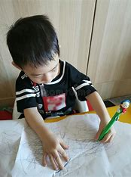
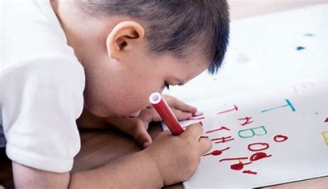
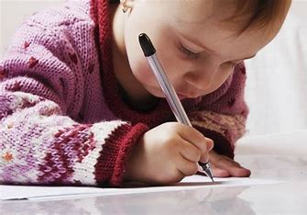
Key things to remember
Children do not learn to write independently by copying adults writing.
Notes:
Copying does not allow them to practise the skill of segmenting
Let your child sound out words themselves and write it how they hear it-celebrate this!! It doesn't have to be spelt perfectly at this age.

Slide 15
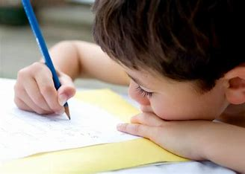
Handwriting
Forming letters correctly=children will have fluent and legible handwriting style
BUT……it can take a long time!!!!
Notes:
Part of the end of year expectations for the Writing ELG are that a child will be able to..
write recognisable letters, most of which are correctly formed-
This means that a child be able to form their letters correctly and not get physically tired by using an inefficient grip again. However learning to form letters takes time.

Slide 16
Handwriting
Say the letter formation phrase as your child writes letters
Especially important when writing their name!
Notes:
Little Wandle has specific formation phrases that help children to remember how to write the letter correctly-really helpful
Some children will have learned to write their name already and that's great but we need to make sure that they form the letters correctly as if not, harder for them to join.

Slide 17
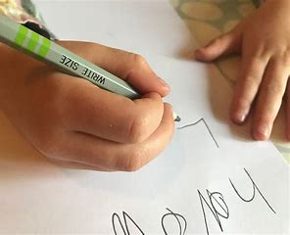
How you can help at home
Complete gross and fine motor activities
Help them to write their name correctly.
Let them see you write.
Give lots of praise and enjoy their attempts
at their spelling
Encourage children to use lower case letters (not capitals) except at the beginning of a sentence or name.

Slide 18
Join us for Busy Fingers!!
Notes:
I'll be around at the end if you want to ask any questions.

