Slide 1
Class Worship
13th September 23

Slide 2
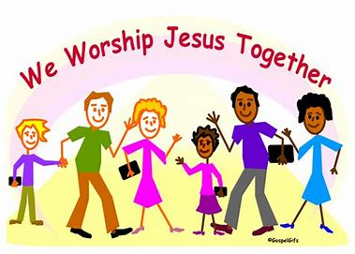
Gathering
Notes:
A member of the class comes up and lights the class candle.
· A member of the class comes and places the Bible on a table.
· The school prayer is said or a greeting used:
Ie:
Leader: The peace of the Lord be with you.
All: And also with you.
Leader: This is the day that the Lord has made.
All: We will rejoice and be glad in it.

Slide 3
Focus: Community
Sit comfortably on the carpet.
Be as still as you can.
Become aware of your breathing.
As you look into the candle flame, think about why community is important.
Notes:
Share the focus for the class worship with the children.
Ensure they are ready to worship and encourage reflection
Children should have their spiritual journals in front of them- either on the carpet or at desks

Slide 4
Engagement
Notes:
A member of the class comes up and lights the class candle.
· A member of the class comes and places the Bible on a table.
· The school prayer is said or a greeting used:
Ie:
Leader: The peace of the Lord be with you.
All: And also with you.
Leader: This is the day that the Lord has made.
All: We will rejoice and be glad in it.

Slide 5
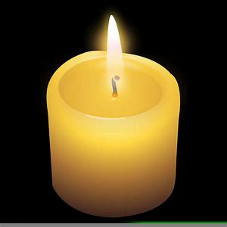
Why is community important?
Discussion and Reflection
Notes:
Engagement part of the worship- discussion in pairs as a class etc after reflection
Check chn understand what community is and give examples first.

Slide 6
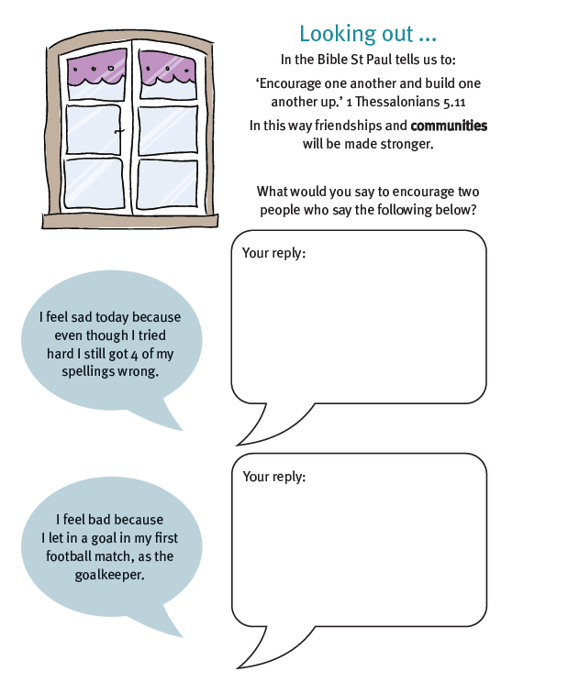
Complete in your spiritual journal.
Notes:
Depending on year group you can adapt- chn could write a speech bubble, draw a picture , write a sentence etc

Slide 7
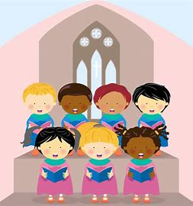
Reflection
Notes:
Choose a song to listen to or sing to that will help the chn reflect- class teacher to choose or you could ask a child in the class to choose depending on age.

Slide 8
Worship Take Away What will you take away from worship today?
Notes:
Complete the weekly take away- what will you take away from this week’s worship?

Slide 9
Sending out
Notes:
End with school prayer or Lords prayer- chn need to know this so class worship is a good chance to teach them and embed both.
Then at the end say the following agreed sending out response…
Help us always to love one another just as you love us. Amen
Chn to sit silence as worship finishes.

