Slide 1
Welcome to the
Moving on to Year 1
Workshop

Slide 2
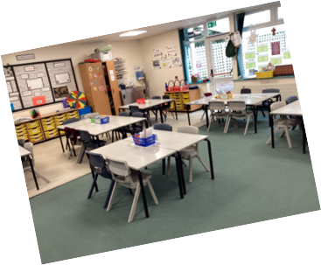
What will Year 1 be like?
I’m scared because I don’t know the room
When you are in Year 1 there are no toys.
I am nervous about my new teacher. I don’t know her
I’m sad. I will miss the sandpit.
I will miss Mrs XXX and I don’t want to go
Notes:
Traditionally……this is how a classroom would look
These are genuine comments from children about to transition into Year 1.
It’s scary for them-lots of the comments are negative-not a great start!!!

Slide 3
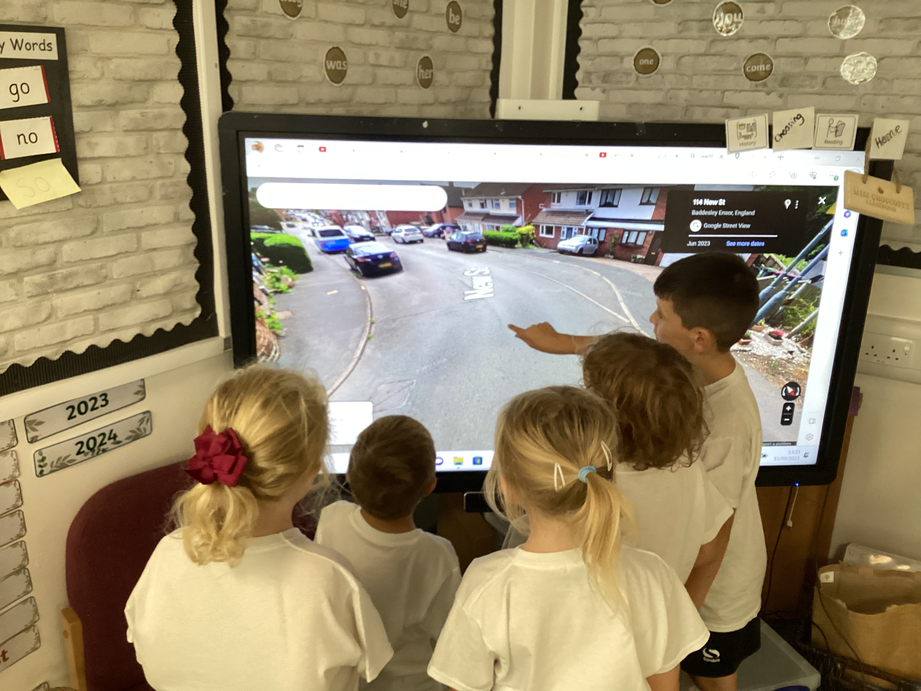
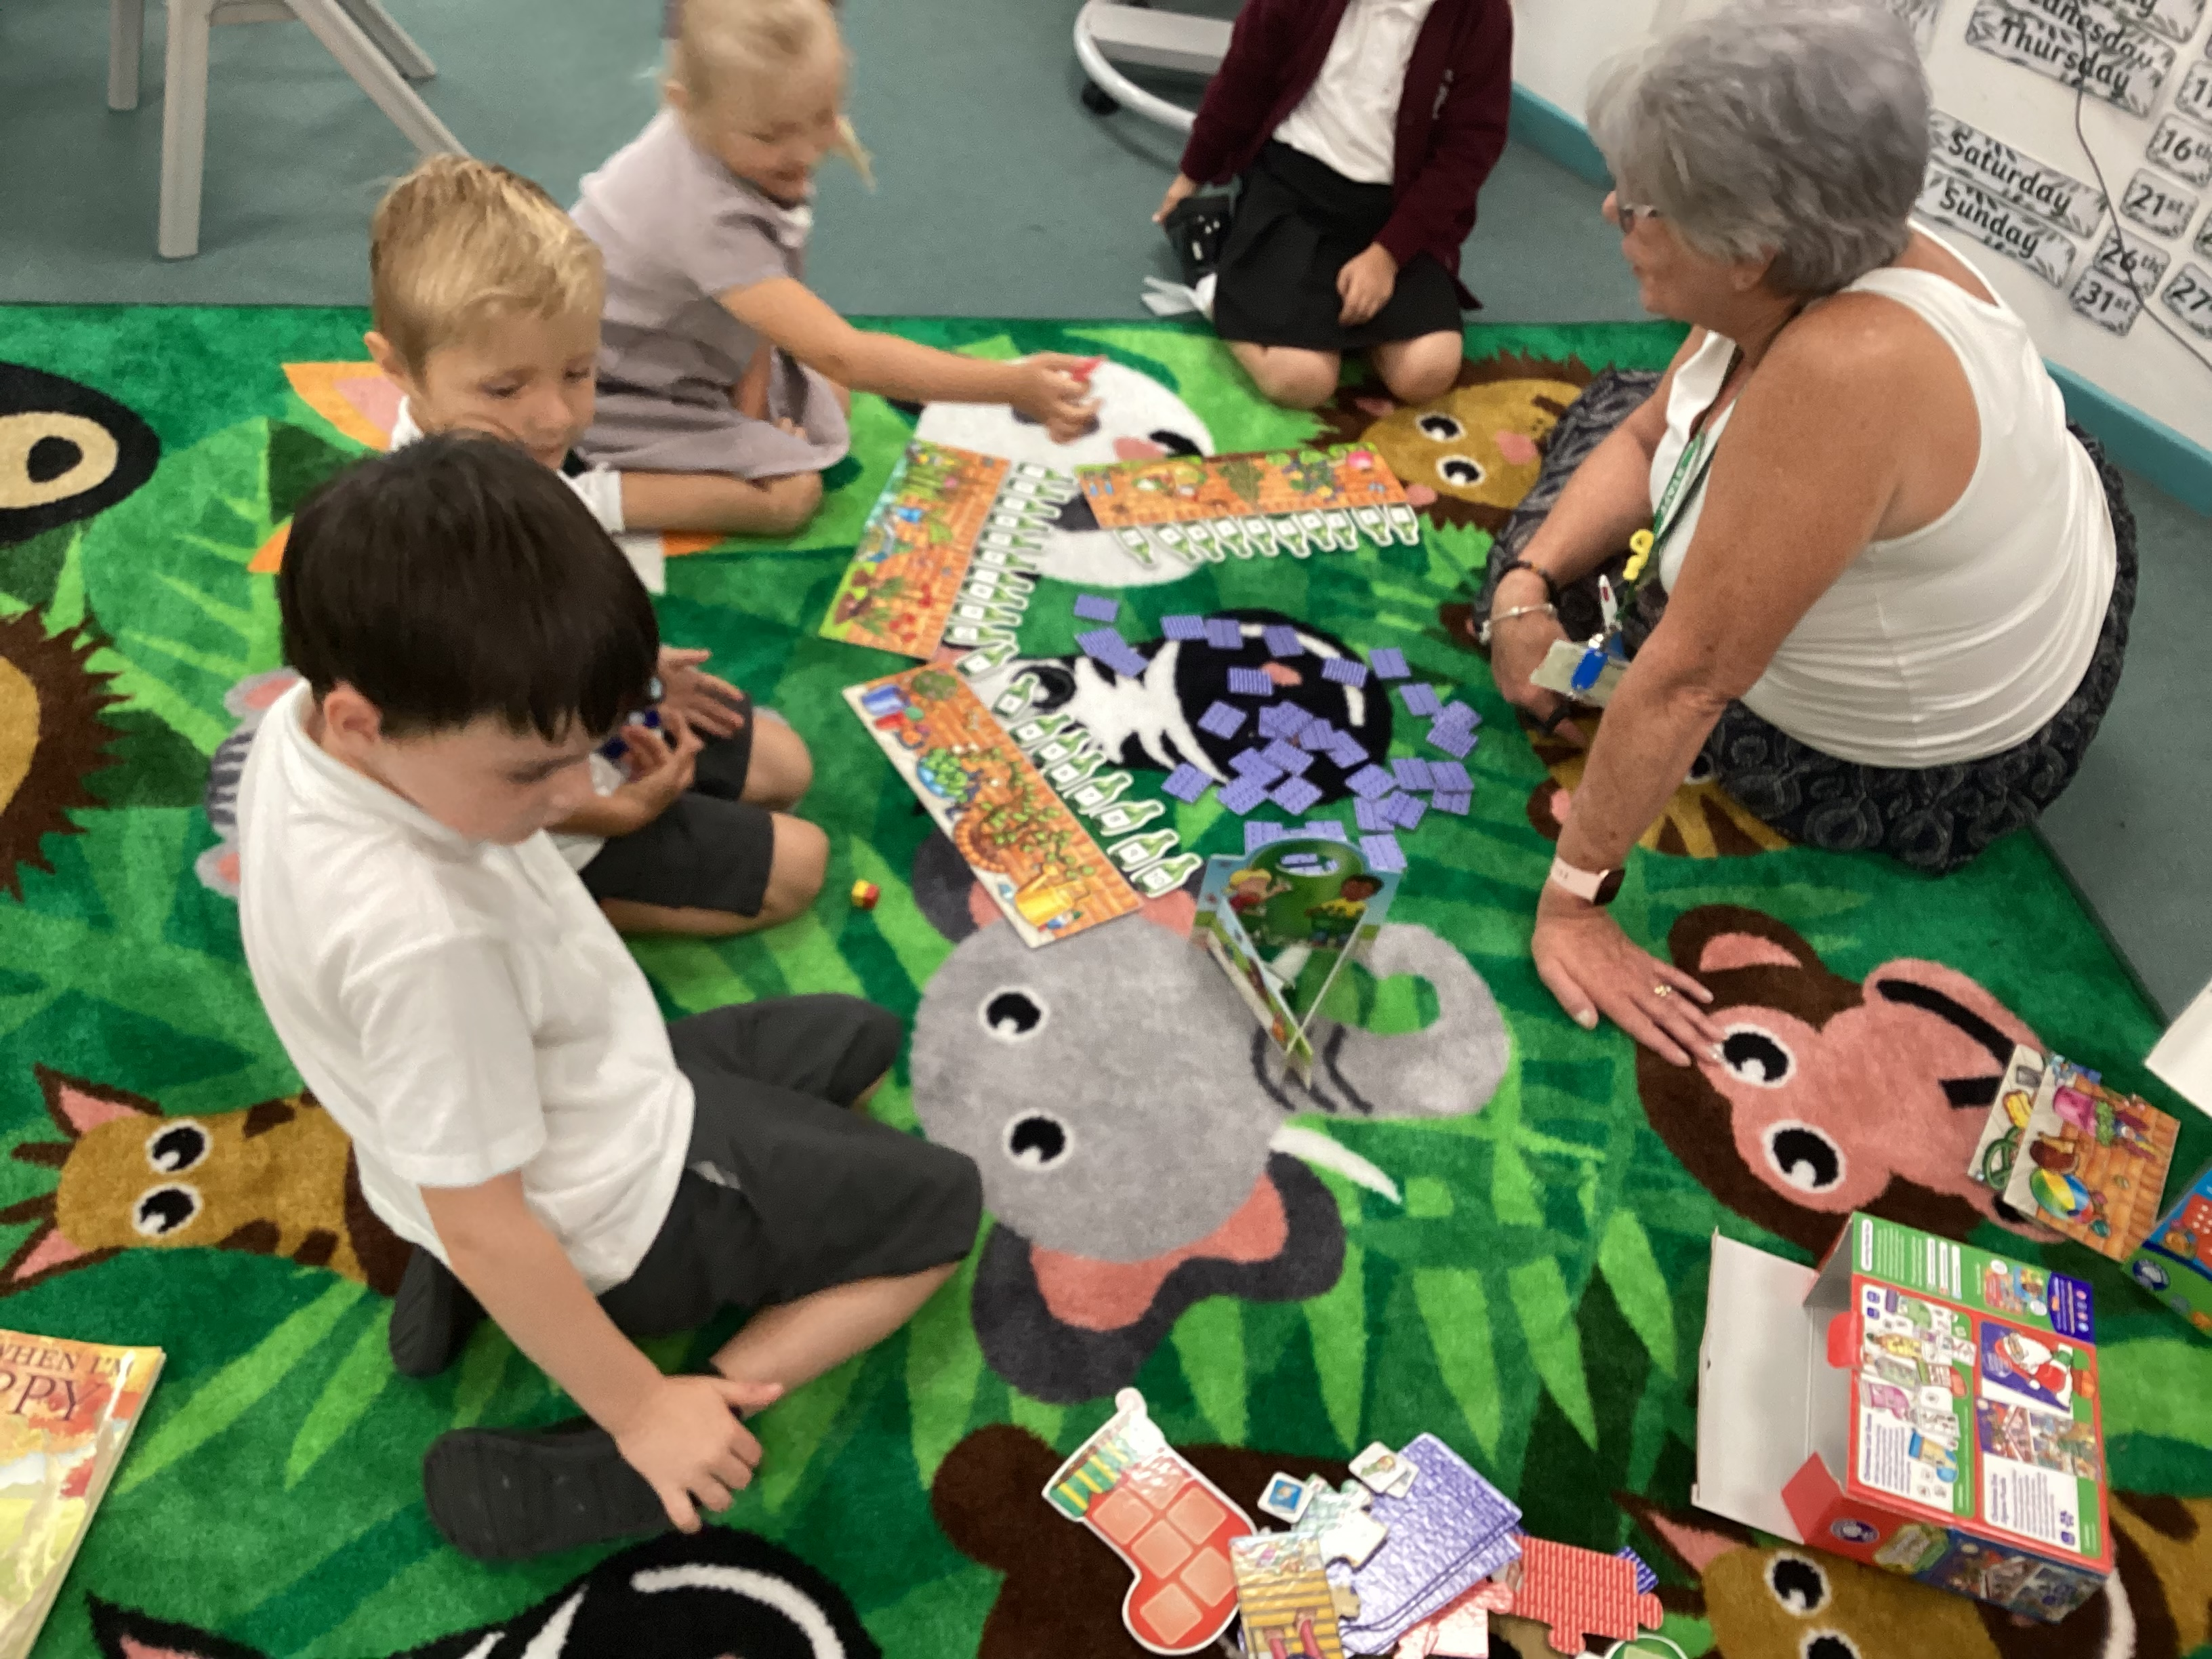
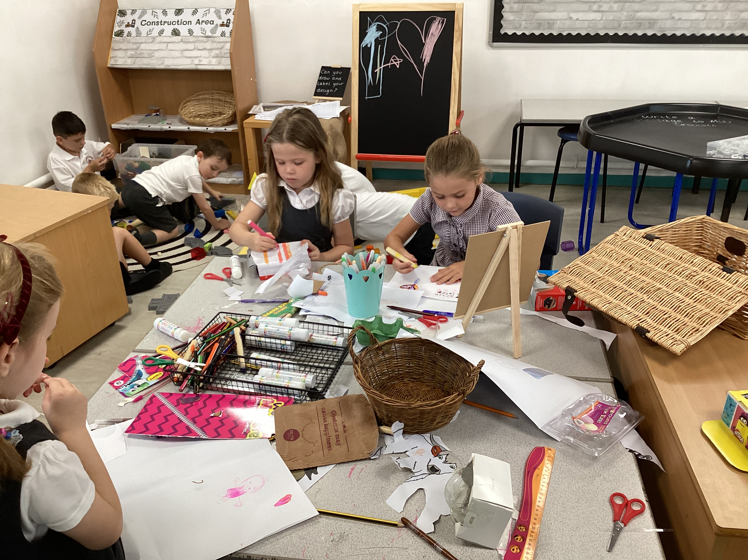
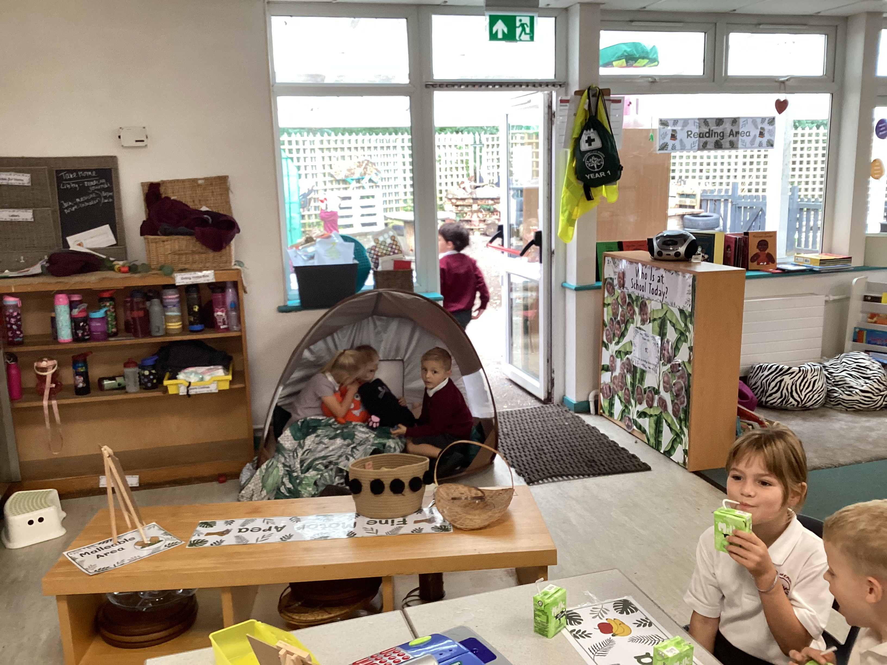
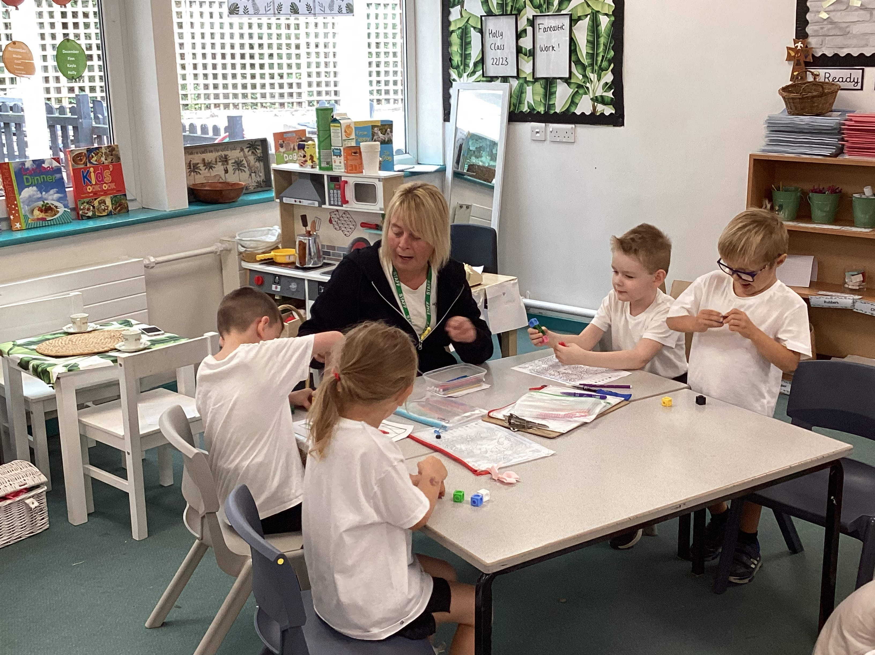
What will Year 1 be like?

Slide 4
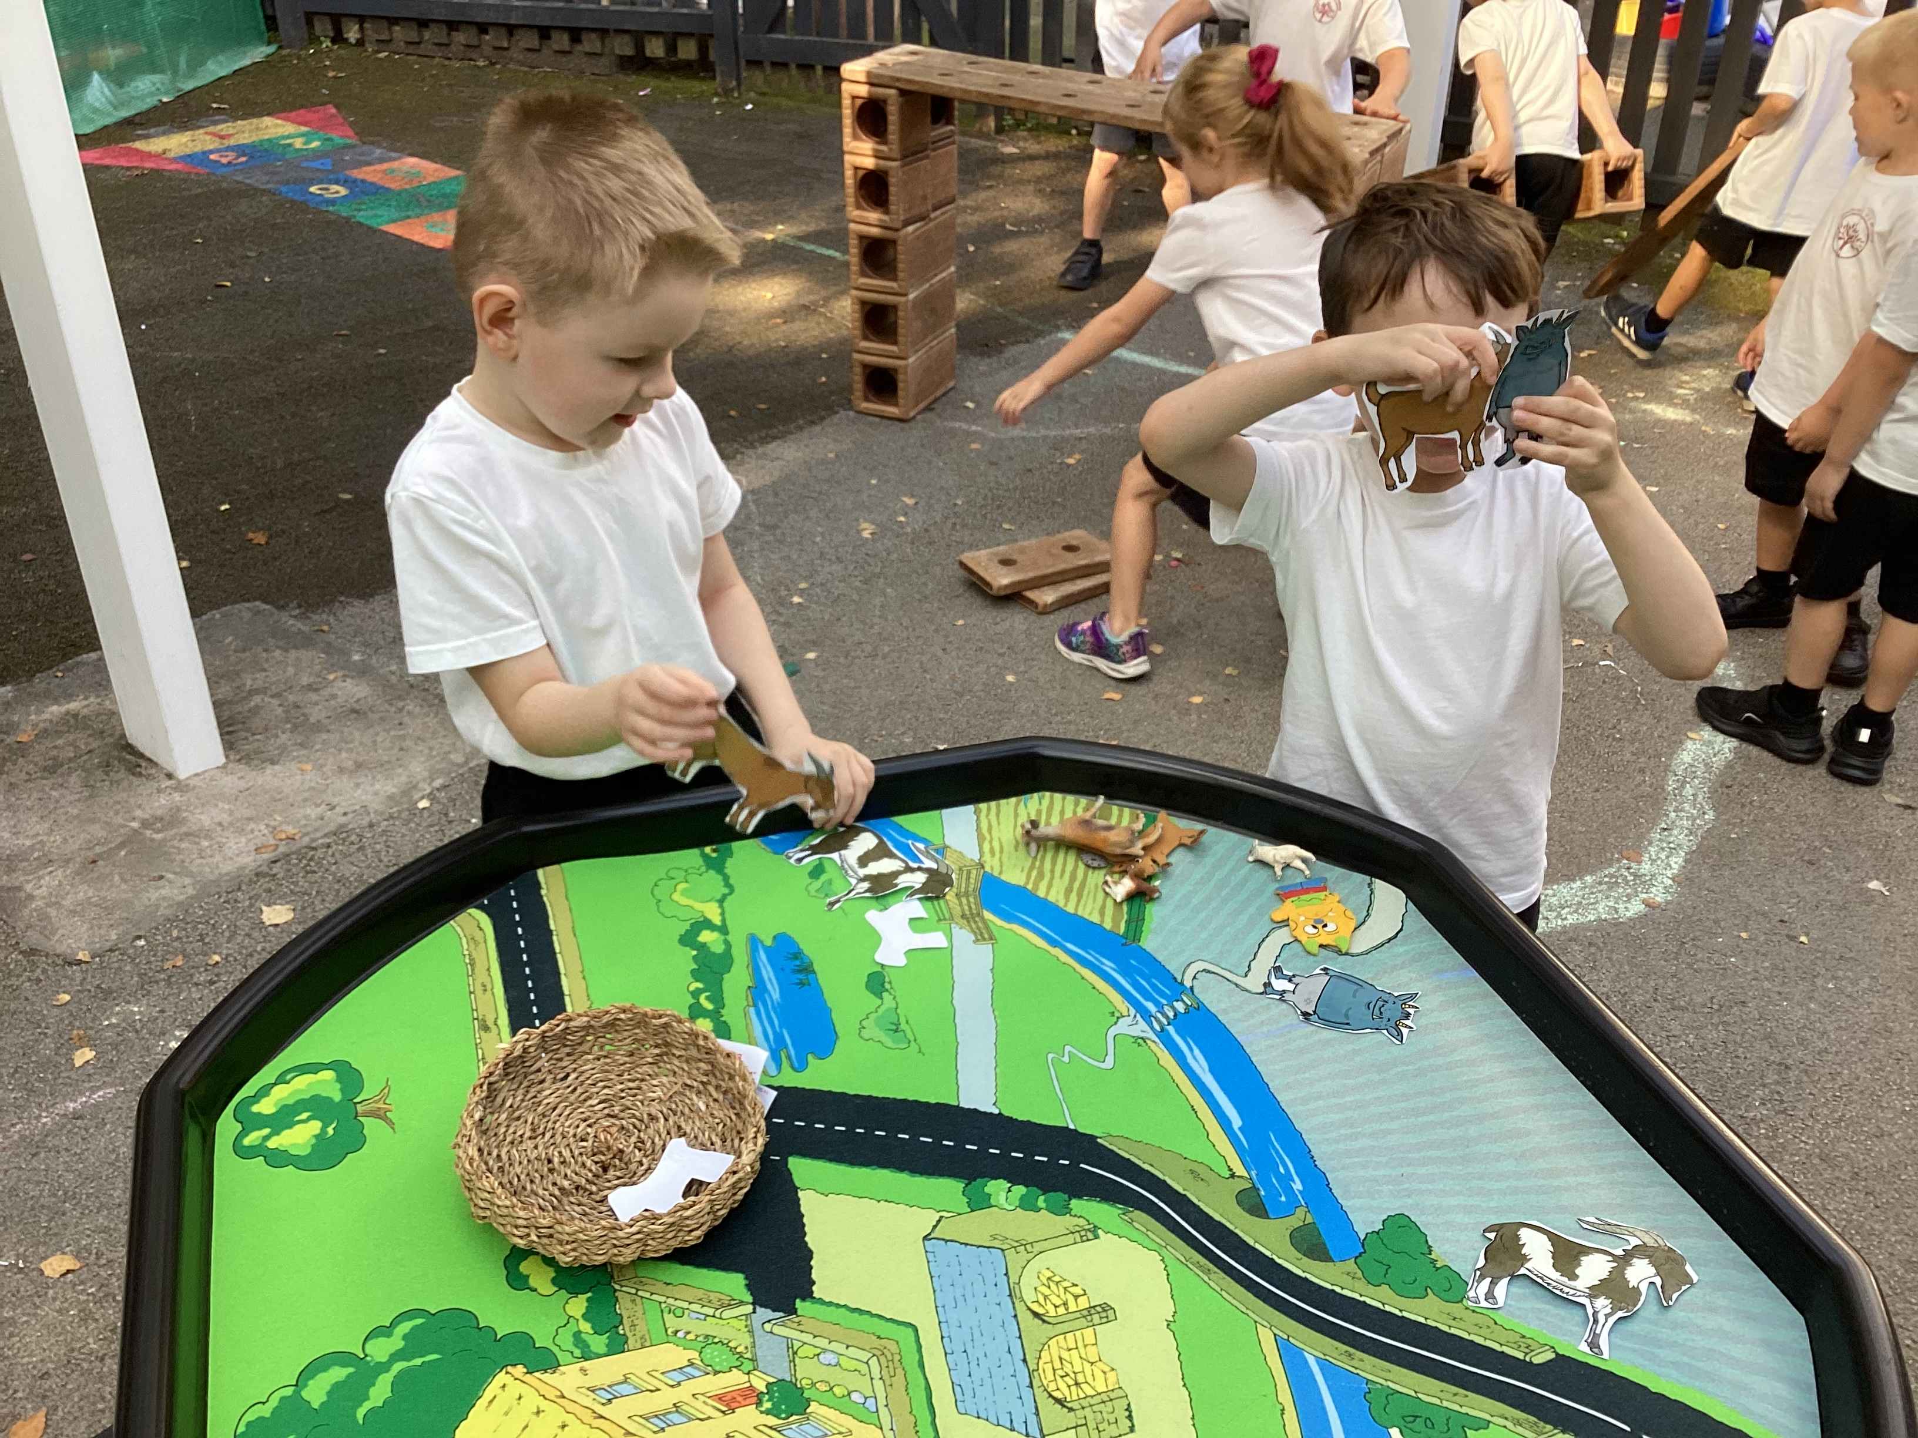
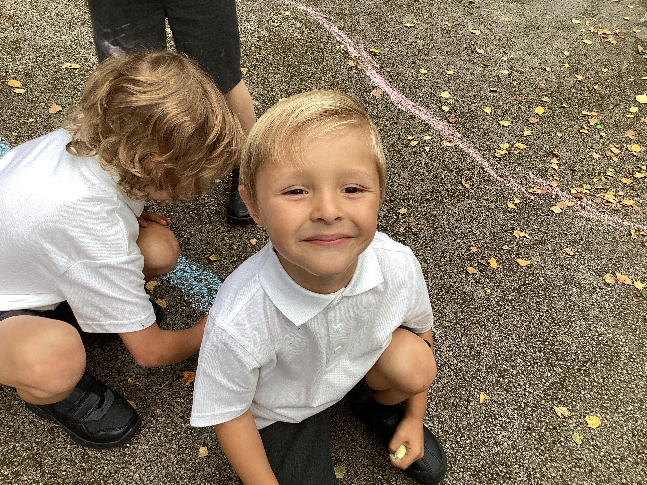
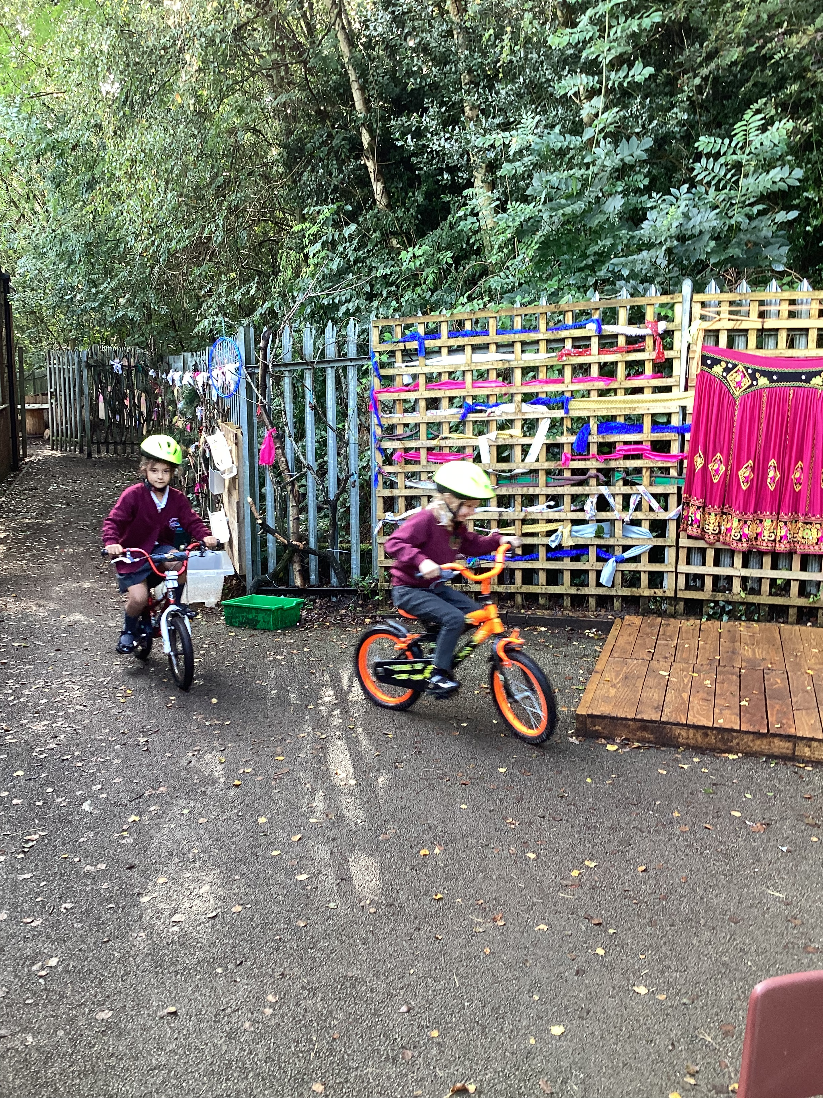
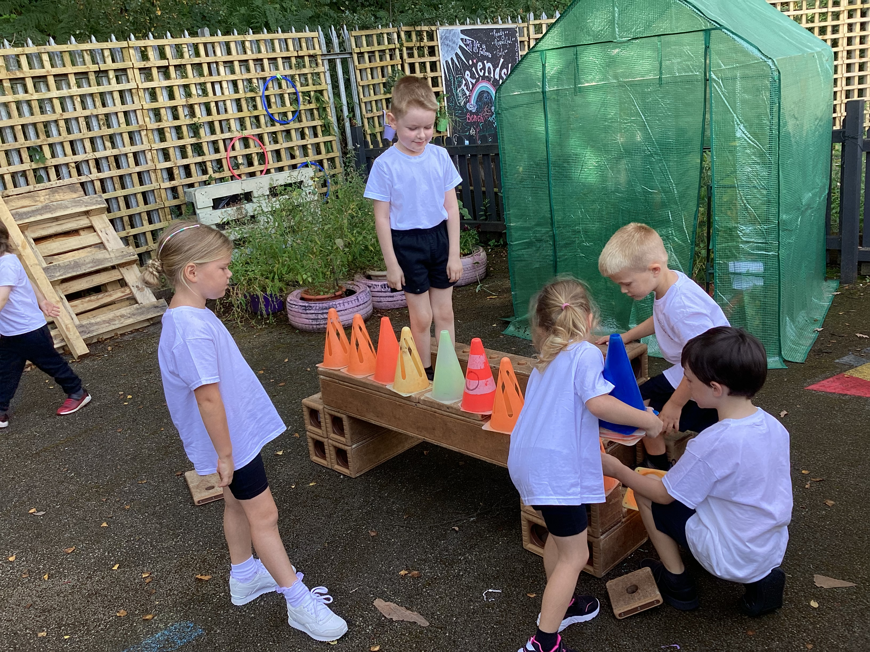
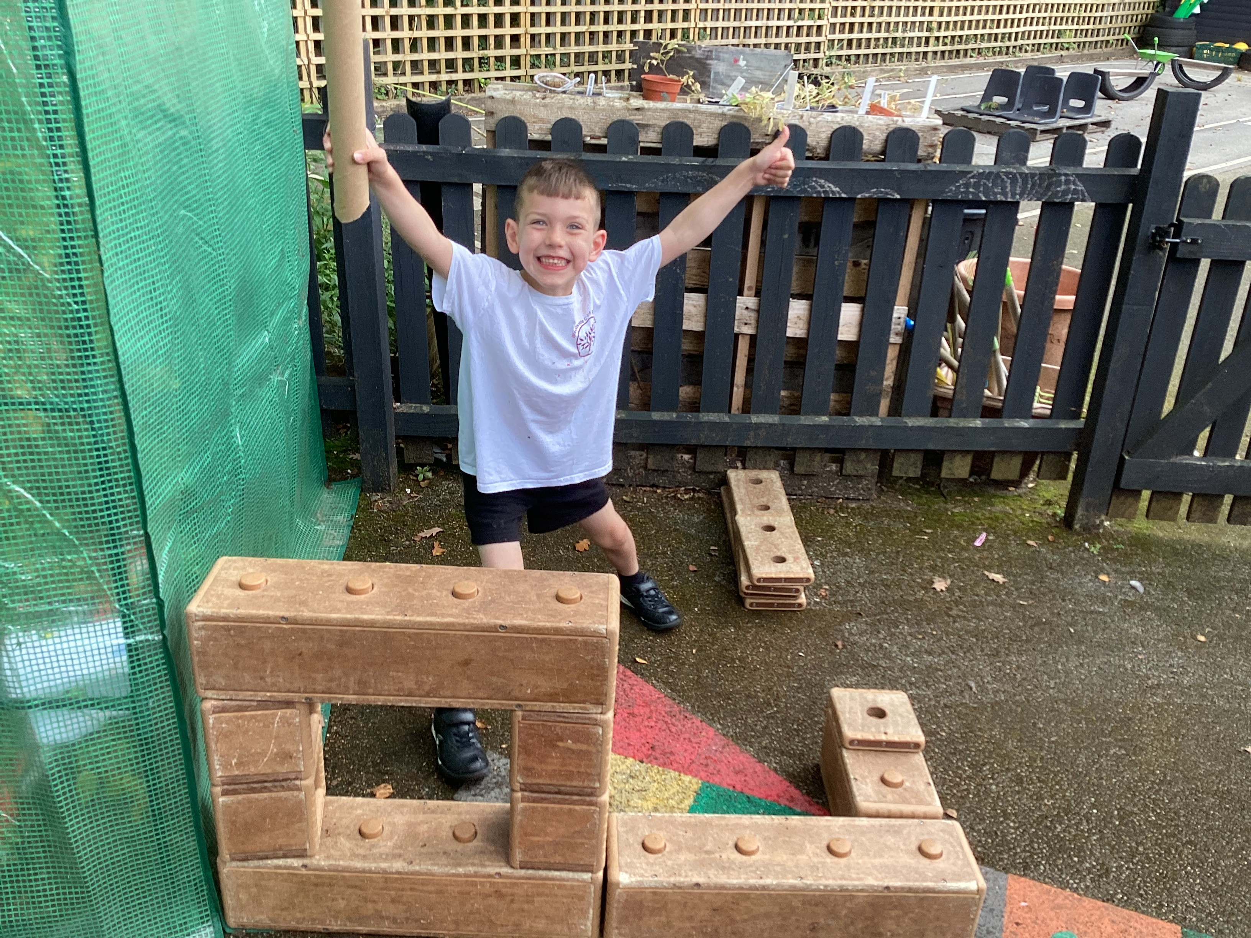
What will Year 1 be like?

Slide 5
Why has Year 1 changed at Woodside?
My own personal experience
Parent voice
Parents worries
BDMAT's aims.
Notes:
Mum-Thomas's exp-creative/imaginative/too formal too soon/turned off school
Teacher-Year 1-crying/upset/unable to access work/well being low
Didn’t get it right in past for several reasons-survey-parents would like info before they start as well in autumn term
Your worries=lots already starting to ask questions
Trust is heavily investing in EY's-important stage/get it right from the start-improve standards/motivation to learn.
As EY lead-been on courses/training/research etc about this-asked to speak at conferences/share our journey to a more sensitive approach to starting Year 1.

Slide 6
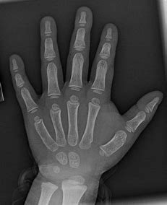
Why has Year 1 changed at Woodside?
Majority of children not ready to be formal…yet
Continue well-being
Our knowledge of child development/research
Success in other countries
Notes:
Majority not ready to be formal-some are, yes and we will be challenging them in different ways, e.g. challenges of learning they have to complete independently and to a certain expected standard, developing life skills of negotiating, working as a team, dealing with failure, being willing to take risks.​
​
Well-being is so important for learning-increases motivation to learn. Attitudes to learning that they have built in Reception are still important for life long learning-Engagement/Motivation/Thinking​
​
Research from Early Years Experts and early child development all state that-children learn best through play/repeated practice
some aspects of their body are not developed enough yet-hands/bones. Gross motor skills/fine motor skills-still need to be developed/refined not just 2x a week in PE but everyday-all these skills so fundamental to future learning at school.​
​
Other countries-best results in education around the world are schools which start formal schooling later-Scandinavian countries. Other UK countries-continue a play based approach up to Year 2 and see the value and benefit of it.​
​

Slide 7
What are the benefits?
High well-being from the start!
Continue to develop good attitudes to learning by being active
Work in small groups
Skills developed over time
High quality interactions
Notes:
High well being from day 1
Active learners=motivated/think/curious
Small groups-T/TA able to support children to become more independent gradually/strong relationships are developed and language are developed.

Slide 8
How do we know it works?
Success of this Year 1!
Regular observations/assessments inform how we progress the curriculum/the room
All the children will be working independently over time.
Pupil voice/parent voice
Continued support from our EY advisor

Slide 9
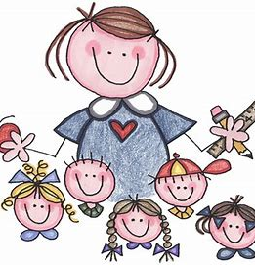
Who will be teaching my child ?
Teacher-Miss Groucott ECT+1
(Early Career Teacher)
Teaching Assistant- Mrs Brown
Regular cover teacher-Mr Lavis
Mrs Clifford-ECT mentor
Mrs Johnson-ECT Mentor Lead
Notes:
Miss Groucott-Early Careers teacher (ECT+1) full time but as part of training has 1 day out of class-training/ppa-covered by regular teacher
Teaching assistant-Mrs Brown
Me-ECT mentor-guiding MG/overseeing the children and their progress Mrs J-overseeing me and MG-in and out of classroom's all the time including mine!!

Slide 10
What will my child be learning in Year 1?
At the end of EYFS-Children are either working towards or at expected standards
Expected children will begin Year 1 National Curriculum
Working towards will continue to work on EYFS expectations
Notes:
End of EYFS-Reception-working towards/expected against 17 areas of learning. If they are expected in the first 12 areas-they are said to have a GLD. Some children will achieve this/some children will not-for various differing reasons and that is ok. GLD/ELG are tools for us to measure attainment not how far the children have progressed.
Those who have achieved GLD/Expected standard will begin work on the Year 1 National Curriculum standards (HANDOUT) however many will still not be ready to sit at desks and work formally and independently of an adult for the majority of the school day.
Children who have not met expected standards are still entitled to receive a curriculum that will help them achieve this standard-a curriculum where they can practice skills such as PSE/GM/FM/S+L but having a formal set up will not support this or allow this to happen.
Therefore we need to create a space/environment that reflects what they already know and feel secure with-resources, rules, expectations and rules and one that reflects the uniqueness of each child, allows them to choose what interests them, feel secure and settled, and thus allows them to be motivated and ready to learn. We recognise that becoming more formal has to happen but it will take time and not just one/two weeks-it is a process where we need to give them time to adjust and mature so they are really ready.

Slide 11
What will my child be learning?
SAME-Jigsaw/Phonics/Guided Reading groups/Literacy/Maths/PE
DIFFERENT-traditional named subjects for curriculum work-History/Art/Computing etc.
Notes:
Some aspects will be the same
PSHE-Jigsaw
Phonics-Guided Reading
Maths
Literacy
DIFFERENT-named specific/traditional subjects-Geography/Science/History/Art/Computing/Design and Technology/Music etc

Slide 12
How will my child be learning?
Whole class carpet sessions
Small group work with T/TA
Continuous provision "play" with T/TA
Independent tasks "Challenges" to extend/practise learning/learn expectations of standards
Notes:
W/C-Literacy/Phonics/Maths/Intro to curriculum subjects
Small grp work-Teacher led- chairs and tables for only about 12 children to sit at enc some children to work more independently but still have T/TA nearby to support/scaffold
CP-areas will be available to the children to access independently when not working with T/TA. Size of room means we cannot have all the areas that we have in Reception but there will be access to a creative area/investigation area/building/book corner/writing/puzzles/small world/counting. We are also going to be developing the outdoors as we are so lucky to have a Year 1 outdoors area. Holding another community day to help develop this area.
We will be carefully selecting resources to go in each area-to develop continuity from Rec to aid familiarity but also adding new resources in to ensure that there is different challenge-to motivate and develop skills and learning.
Independent challenges will encourage children to be more independent and to develop an expectation of standards of work.

Slide 13
How is this different from before?
Continuous provision was used for initial week or so
Children sat at tables to work right from the start
Children expected to work more independently of an adult from the start!!
Notes:
Play/toys/choice removed after a couple of weeks
Sat at tables to work from early in September
Children expected to work more independently of T/TA from Sept.

Slide 14
What can I do as a parent?
Talk positively about the move
Discuss things they will do-things that are the same/different
Keep communicating with us!
Notes:
Positive-be enthusaistic-talk about feelings-it is ok to nervous/sad about leaving Reception but it is exciting to have a new room/teachers-growing up getting bigger-not the littlest children in school anymore
Talk about what they will do-things that will be the same/different-HANDOUT
Relationships are key-we both want the best for your child. MG feels the same and their will be opportunities to speak to her-drop off and pick ups are TBC as Mrs J wants to change how this is organised in September. There will be a different place to do this-more info to come.

Slide 15
How can I help my child to be ready for Year 1?
Encourage them to....
know all the letter sounds taught this year
develop their core strength
manage and organise themselves and their belongings
concentrate for at least 15 mins
have good pencil control
independently blend words to read
independently use phonics to write phrases
use scissors confidently
Notes:
Positive-be enthusaistic-talk about feelings-it is ok to nervous/sad about leaving Reception but it is exciting to have a new room/teachers-growing up getting bigger-not the littlest children in school anymore
Talk about what they will do-things that will be the same/different-HANDOUT
Relationships are key-we both want the best for your child. MG feels the same and their will be opportunities to speak to her-drop off and pick ups are TBC as Mrs J wants to change how this is organised in September. There will be a different place to do this-more info to come.

Slide 16
How can I help my child to be ready for Year 1?
Encourage them to....
know some number facts
count accurately
regularly read or share books at home
recognise numbers
speak in full sentences
be ready, respectful and safe
manage their own hygiene
self-regulate emotions
Notes:
Positive-be enthusaistic-talk about feelings-it is ok to nervous/sad about leaving Reception but it is exciting to have a new room/teachers-growing up getting bigger-not the littlest children in school anymore
Talk about what they will do-things that will be the same/different-HANDOUT
Relationships are key-we both want the best for your child. MG feels the same and their will be opportunities to speak to her-drop off and pick ups are TBC as Mrs J wants to change how this is organised in September. There will be a different place to do this-more info to come.

Slide 17
How can I help my child to be ready for Year 1?
Encourage them to....
know all the letter sounds taught this year
develop their core strength
manage and organise themselves and their belongings
concentrate for at least 15 mins
have good pencil control
independently blend words to read
independently use phonics to write phrases
get on well with peers and adults
use scissors confidently
Notes:
Positive-be enthusaistic-talk about feelings-it is ok to nervous/sad about leaving Reception but it is exciting to have a new room/teachers-growing up getting bigger-not the littlest children in school anymore
Talk about what they will do-things that will be the same/different-HANDOUT
Relationships are key-we both want the best for your child. MG feels the same and their will be opportunities to speak to her-drop off and pick ups are TBC as Mrs J wants to change how this is organised in September. There will be a different place to do this-more info to come.

Slide 18
What happens next?
Children to meet Miss Groucott/Mrs Brown in Reception classroom during play
Story swaps
Visit the Year 1 classroom with Mrs Clifford/Mrs Marsh
Move on up day 10th July
Meet the teacher meeting
First weeks back in September
Notes:
We need the children to feel safe and secure with their new teachers and their new environment to make sure that their well being remains high.
They have already met MG and VB. We will swap with them so that they can come into Reception and play.
We went and had a little peek in the Year 1 classroom when Year 1 were on their trip. The children sat on the carpet and tried to spot what was the same and what was different. They were shown where to put their coats and where the toilet were. They even used them!!!
We will continue to go into the Year 1 classroom to listen to stories with either myself or Mrs M.
Wk/beg-26/6-MG joins us-shadowing me/watching observing lessons/routines/expectations/getting to know the children
Wk beg 3/7 Drop in Coffee morning Tues 4th July-get to know MG in an informal way-not a Q+A session 8.40-9.10am
Transition day Wed 5th July-Children spend all day in Year 1 with new T/TA
MG will have several opportunities over the 3 weeks to teach the Reception children-small sessions or whole am/pm-children will get to know her and her them even more.
Meet the teacher-Sept.

Slide 19
Any questions...?
Notes:
Any questions?
If you do not want to ask now...I'll be here or ask us later date if they pop up later.
Main take away-want our transition to be smooth for our children so that they are motivated, keen and secure to have a flying start to Year 1.

